Slide 1
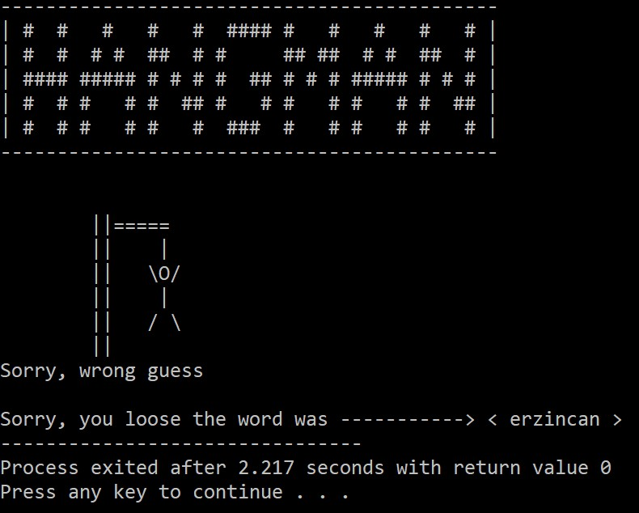

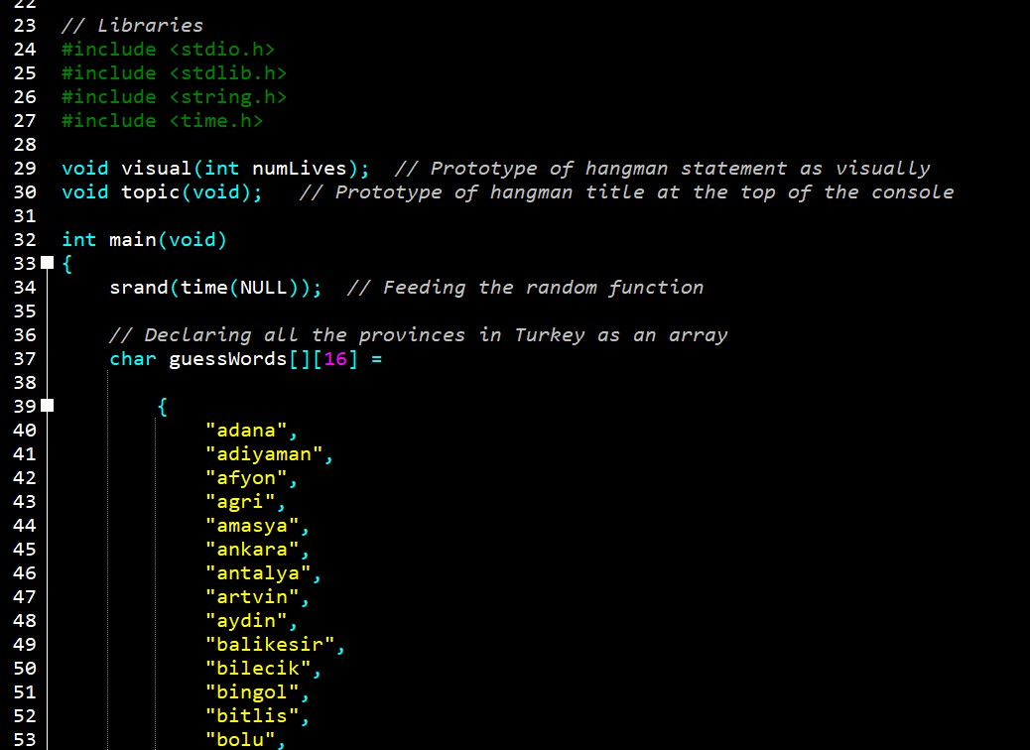
Hangman Game
Adem onur Öztaş | 1904010025
Mert Altuntaş |1804010005

Slide 2
Project Definition
The definition of the project is creating a game called Hangman which contains all of the cities in Turkey with C Programming language.
When we are coding our project we struggled at some certain points such as using multidimensional char arrays in an effective and compact way also creating a simple GUI which will not cause some bugs and unwanted errors in the future if someone wants to develop on it
It was expected from us to learn new functions , structures etc. in order to create hangman game and we believe learning something new what we don’t know and forcing ourselves out of our comfort zone was the main purpose of the project.
Our aim was not only to code the hangman game, also was creating and developing some extra features above itself.

Slide 3
Hangman Game’s Rules
One player thinks of a word or phrase; the others try to guess what it is one letter at a time. The player draws a number of dashes equivalent to the number of letters in the word.
If a guessing player suggests a letter that occurs in the word, the other player fills in the blanks with that letter in the right places. If the word does not contain the suggested letter, the other player draws one element of a hangman’s gallows.
As the game progresses, a segment of the gallows and of a victim is added for every suggested letter not in the word. The number of incorrect guesses before the game ends is up to the players, but completing a character in a noose provides a minimum of six wrong answers until the game ends. The first player to guess the correct answer thinks of the word for the next game.

Slide 4
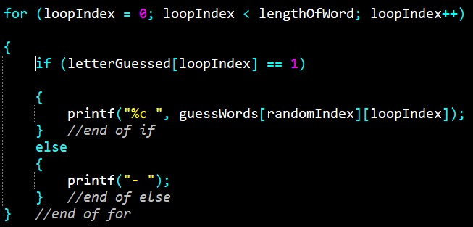
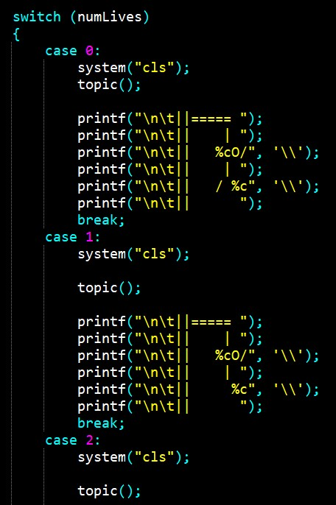
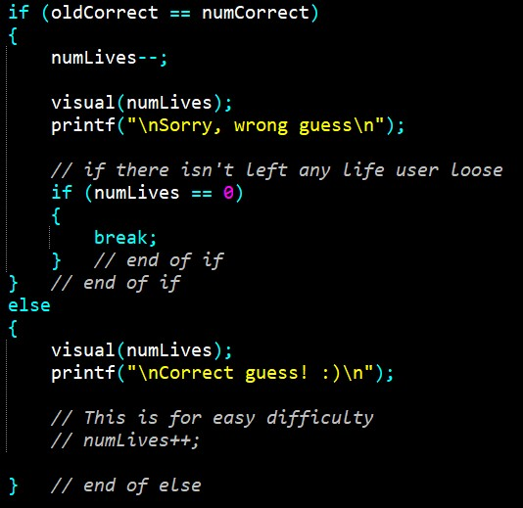
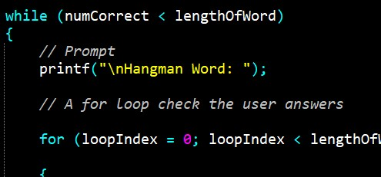
Structures
if-else Conditions : for Loop : switch-case :
while Loop :

Slide 5
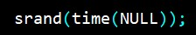
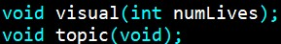
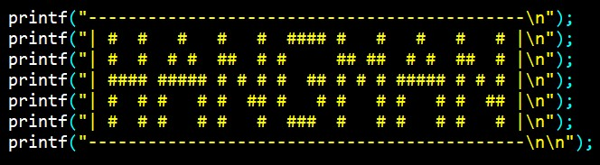
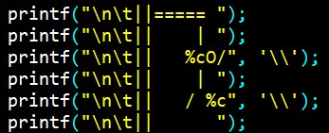
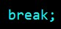
Functions, Variable Types, Arrays and Statements
Random Number Generator Function :
Variable Types :
Arrays :
Special Functions :
printf Function :
Break and Continue Statements :

Slide 6
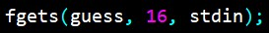
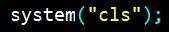
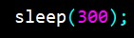
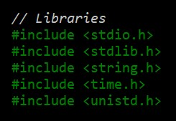
New Structures
strlen Functions:
fgets Funciton :
system Funciton :
sleep Function :
Libraries :

Slide 7
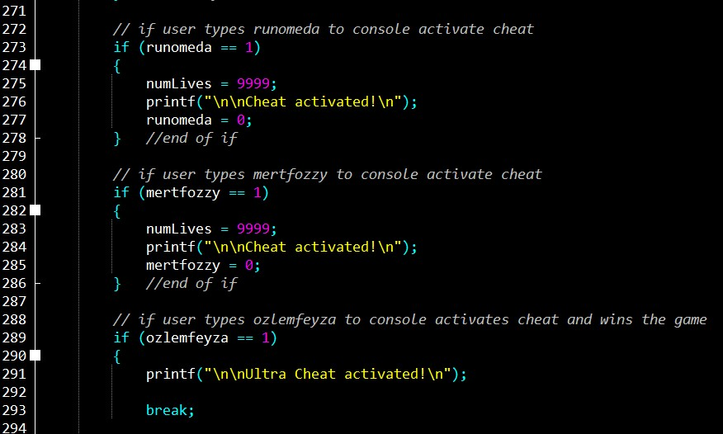

Slide 8
